Slide 1
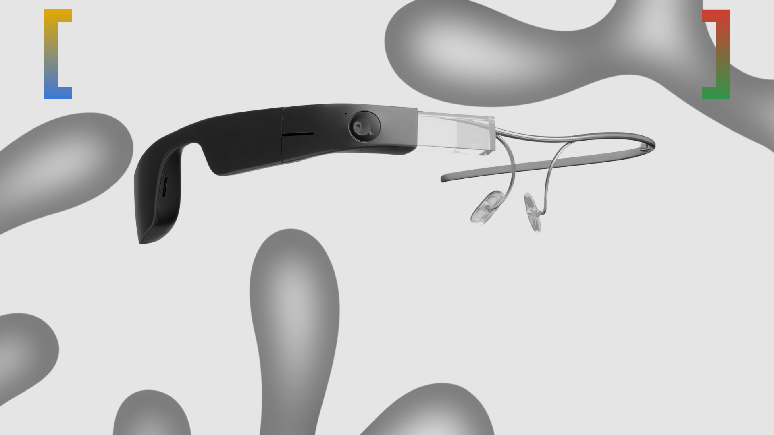
Why Google Glass Failed
An analysis of the ambitious project's rise and fall
What Was Google Glass?
The Hype vs. The Reality
The Price Point
Major Privacy Concerns
Awkward Design
Lack of a Clear Purpose
The Glasshole Effect
The Enterprise Edition: A Second Life?

Slide 2

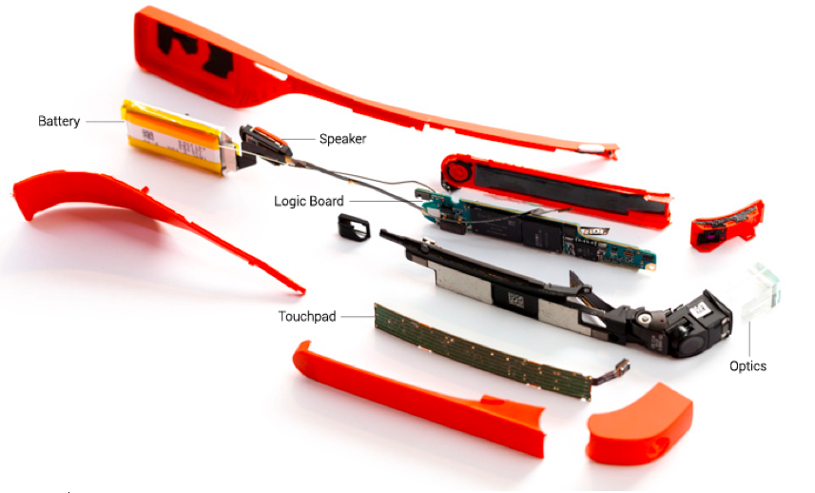
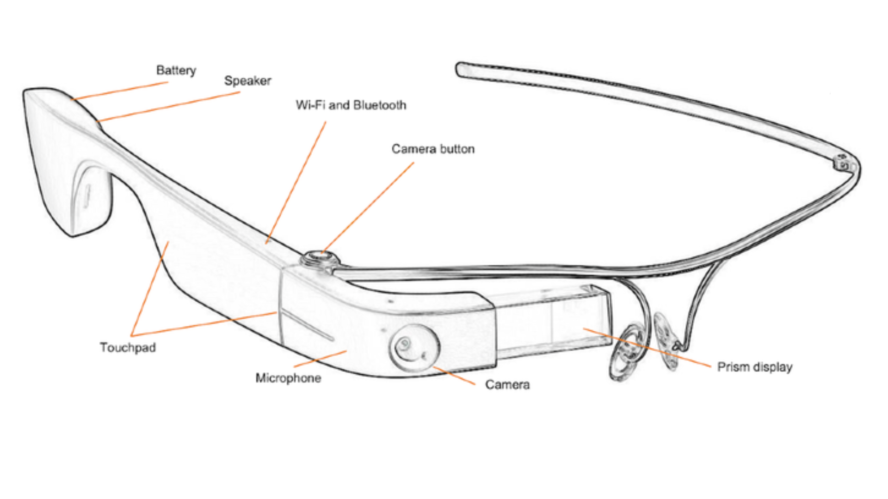
What Was Google Glass?
∙ A wearable, voice-controlled Android device.
∙ It featured a small screen, a camera, and a bone-conduction speaker.
∙ It was designed to provide a hands-free, augmented reality experience.
∙ The "Explorer Edition" was released to developers and early adopters in 2013 for $1,500.

Slide 3
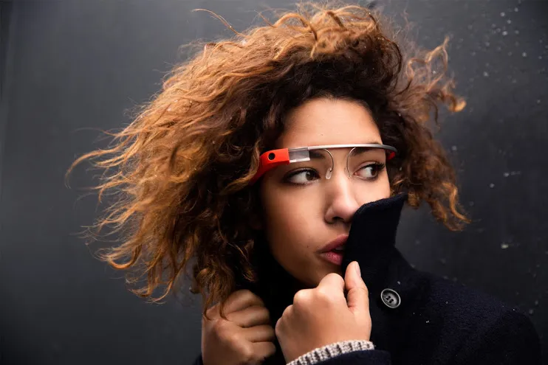
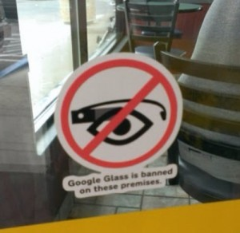
The Hype vs. The Reality
The Hype:
∙ A revolutionary device that would change the way we interact with technology.
∙ Featured in high-fashion magazines and worn by celebrities.
∙ Promised a future of seamless augmented reality.
The Reality:
∙ A clunky, unfinished prototype.
∙ Limited functionality and poor battery life.
∙ A host of technical and social problems.

Slide 4

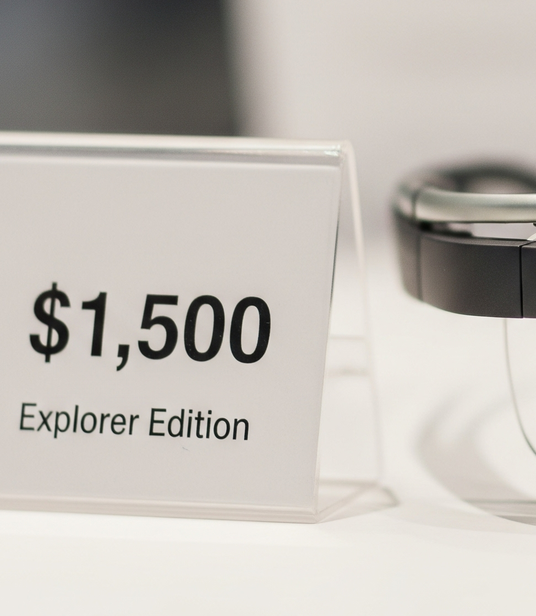
The Prohibitive Price Point
∙ The Explorer Edition cost $1,500.
∙ This was far too expensive for the average consumer, especially for a first-generation device with limited functionality.
∙ The high price created an image of elitism and exclusivity, which alienated many potential users.
∙ The bill of materials was estimated to be around $80, which made the high price tag even more difficult to justify.

Slide 5
Estimated Sales Figures

Slide 6
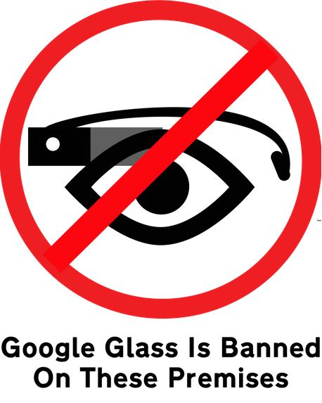
Major Privacy Concerns
∙ The built-in camera raised serious privacy questions.
∙ The ability to record video and take pictures discreetly made people uncomfortable.
∙ The term "Glasshole" was coined to describe users who were perceived as invading the privacy of others.
∙ Many businesses, such as bars and movie theaters, banned the use of Google Glass on their premises.

Slide 7

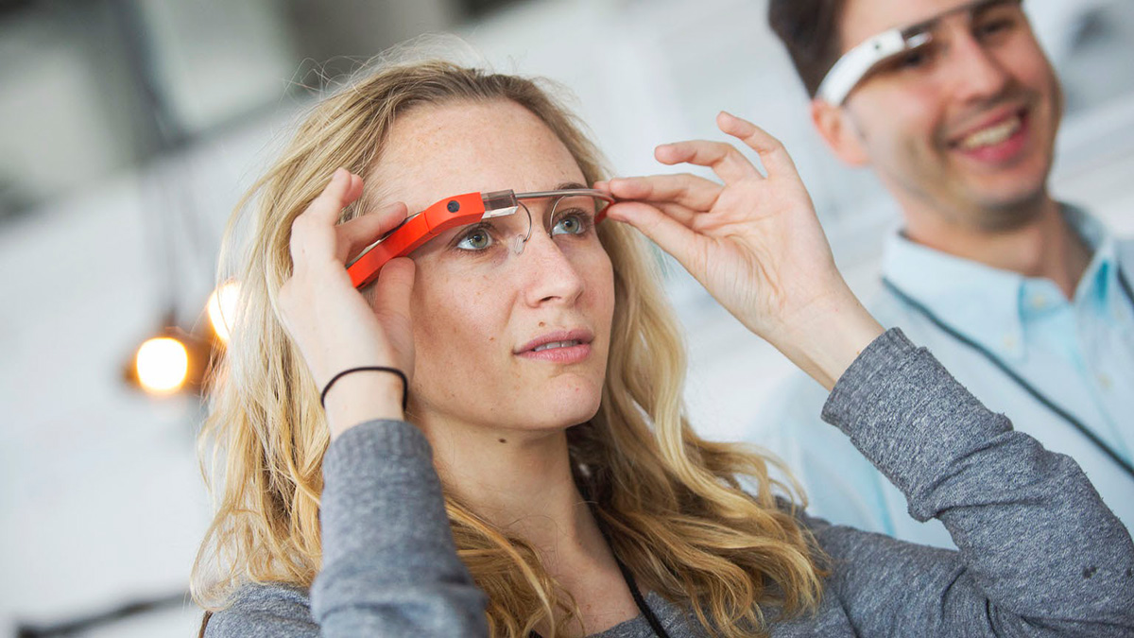
Awkward and Unfashionable Design
∙ The device was bulky, lopsided, and generally considered to be unattractive.
∙ It was not a device that people felt comfortable wearing in public.
∙ The design screamed "tech gadget" rather than "fashion accessory."
∙ Despite collaborations with fashion designers, the fundamental design remained a major turn-off for consumers.

Slide 8
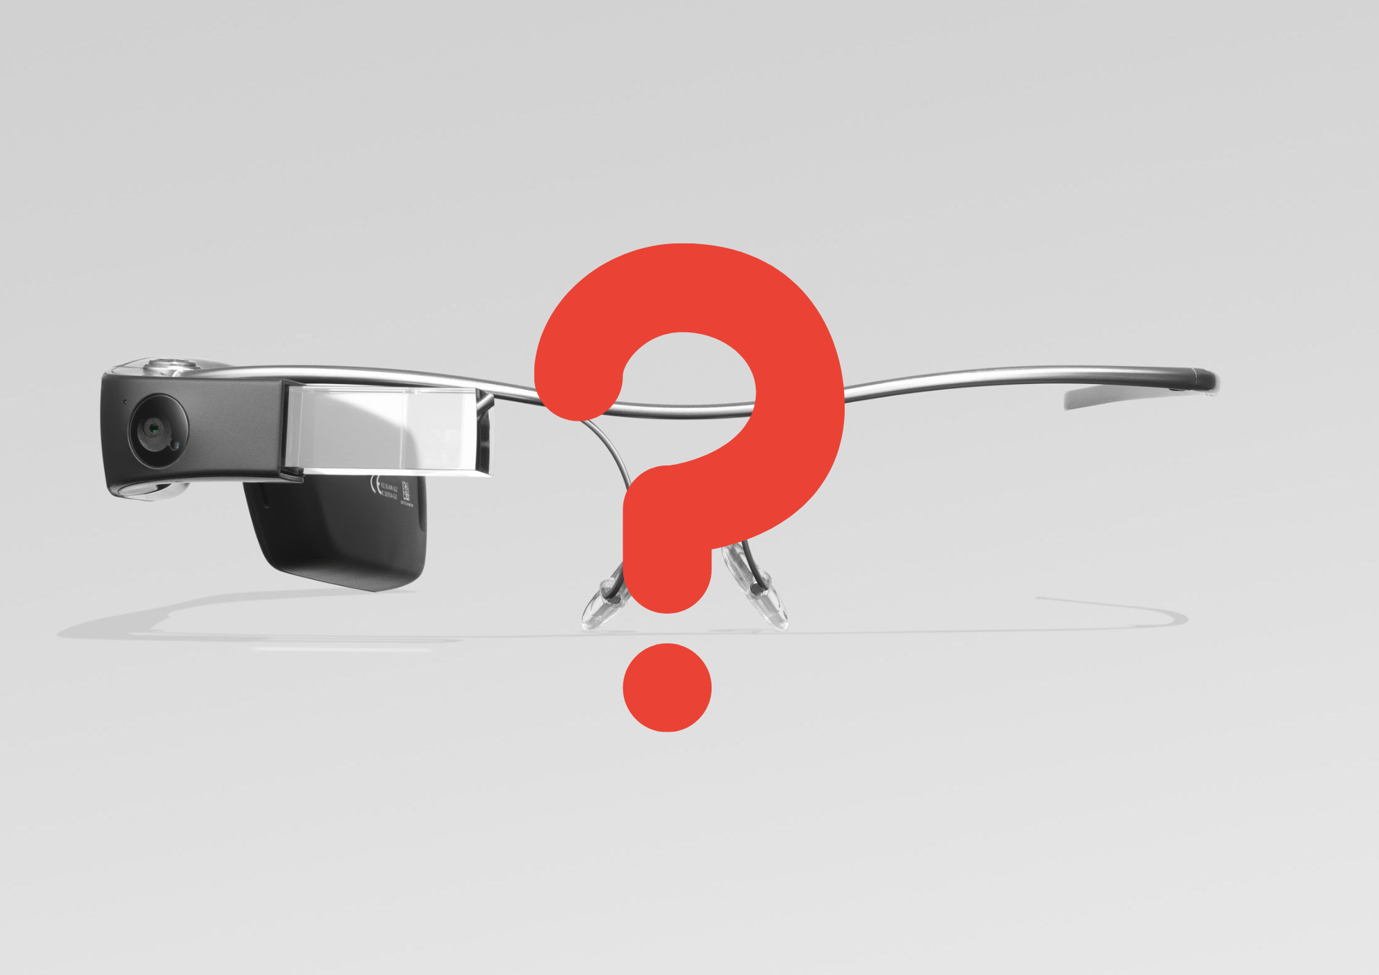
Lack of a Clear Purpose
∙ Google Glass was a solution in search of a problem.
∙ There was no single, compelling use case that made the device a "must-have."
∙ The functionality it offered could be easily replicated by a smartphone.
∙ Without a clear purpose, it was difficult for consumers to justify the high price and social awkwardness.

Slide 9

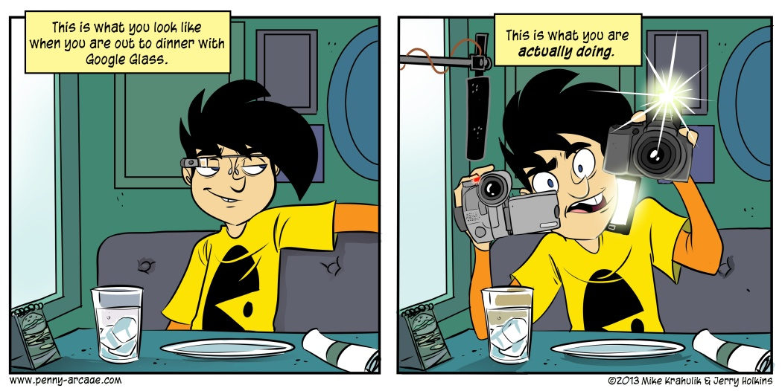
Social Awkwardness and the "Glasshole" Effect
∙ Wearing Google Glass in public was a socially awkward experience.
∙ It created a barrier between the user and the people they were interacting with.
∙ The device was seen as a sign of social disengagement and a potential invasion of privacy.
∙ The negative social stigma was a major deterrent for potential users.

Slide 10
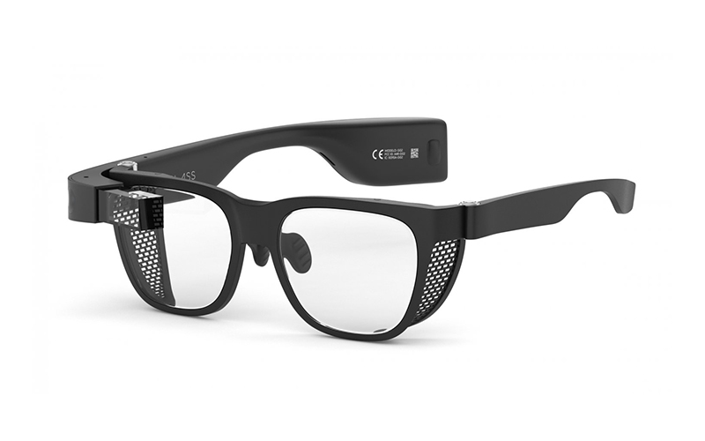
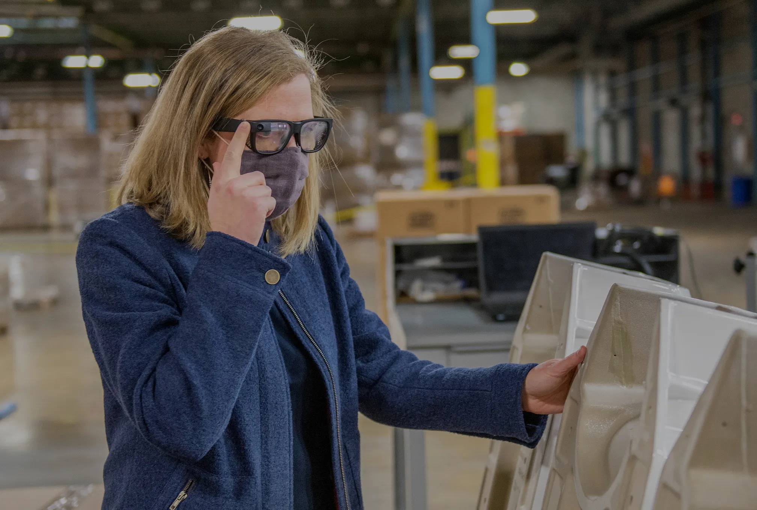
The Enterprise Edition: A Second Life?
∙ Google eventually discontinued the consumer version of Glass in 2015.
∙ However, the company pivoted to the enterprise market with the "Glass Enterprise Edition."
∙ This version of the device has found success in industries like manufacturing, logistics, and healthcare.
∙ In these contexts, the hands-free functionality and augmented reality features provide real value.
∙ But even those efforts were ultimately discontinued due to the tool's low impact on daily life.

Slide 11


Lessons Learned
∙ Don't release a prototype as a consumer product: The Explorer Edition was not ready for the public, and the negative first impression was difficult to overcome.
∙ Privacy is paramount: In the age of connected devices, privacy must be a primary consideration in product design.
∙ Design and social acceptability matter: For wearable technology, fashion and social norms are just as important as functionality.
∙ A clear value proposition is essential: A new product needs to solve a real problem or offer a compelling new experience to succeed.

Slide 12
Thank You
Made by: Ahmed Ismail, Manil Laroussi, and Ahmed Al Ali

